Slide 1
IDIH Project

Slide 2
IDIH Short Fact Sheet
Full Title: International Digital Health Cooperation for Preventive, Integrated, Independent and Inclusive Living
Start Date: 1st May 2019
Aim: Promote and increase international collaboration to advance digital health in the EU and key Strategic Partner Countries to support active and healthy ageing (AHA) through innovation
9
Partners
4
EU Countries
5
Strategic Partner Countries
36
months
(May 2019
- April 2022)
2.4 million €
(including partners’ own contribution)

Slide 3
Background
The population is rapidly ageing in industrialised and emerging economies. Health risks need prevention, treatment of health issues needs assistance, as well as access to innovations not only for the elderly but also for other patient groups.
Health systems around the world should learn from each other. Sharing experiences, innovative approaches and best practices will be key to accelerating the progress of individual regions.
Joint efforts and mutual learning for the benefit of the society and industry on a global level is vital.
IDIH is operating as a catalyst for the international dialogue in digital health.

Slide 4
Four Targeted Objectives
To support the definition of common priorities to enhance strategic international cooperation in digital health.
To facilitate the exchanges between RTI stakeholders from the EU and the Strategic Partner Countries in digital health.
2
4
To provide specific contributions to the international dialogue in digital health with the creation of a Digital Health Transformation Forum.
To foster international collaboration for digital solutions in health care benefitting the society.
1
3

Slide 5
Approach
An expert-driven approach ensures the involvement of RTI and policy stakeholders, as well as user associations where relevant.
IDIH has set-up an expert-driven “Digital Health Transformation Forum”, gathering global top-notch experts, executives and advocacy groups with the aim to:
Pave a path that overcomes fragmentation in R&I Investments in AHA,
Tackle system biases in AHA e.g., in terms of gender, regions, cultures etc.,
Generate impact from EU and international programs,
Target future trends and drivers of high impact and disruption in AHA
The “Digital Health Transformation Forum” is expected to become a long-lasting mechanism for an international dialogue.
Main output: A Roadmap towards international cooperation in the field of Digital Health for AHA (to be published in spring 2022!)

Slide 6
Four Strategic Topics
Preventive care
Focus: Early diagnosis and detection
Active and healthy aging begins with a prolonged health regimen. Tech-enabled solutions that engage users in health and wellness techniques will allow active and meaningful senior lifestyles.
Integrated care
Focus: Using new technologies to redesign, coordinate and integrate health and social services and place citizens, patients and seniors at the centre of health systems.
Technology in the integrated care domain is intended to provide support at the point of care, anytime and anywhere.
Independent and connected living
Inclusive living
Focus: Tele-monitoring via smart home and living technologies
Connected living is made possible through smart sensors and buildings, mHealth solutions, mobility aids, secure data, robotics, and e-health.
Focus: Helping the elderly to feel socially more connected
Healthy environments equal healthy individuals. In the aging population, a component of healthy living is inclusivity, promoting positive social engagement, and ensuring a rewarding social aspect to age.
A PEOPLE-CENTRED APPROACH
Health
Wellbeing

Slide 7
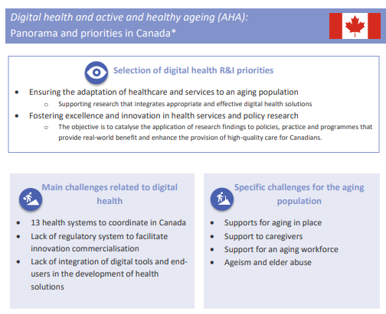
IDIH FACTSHEETS
Overview of the digital health research and innovation (R&I) landscape in Strategic Partner Countries : priorities within digital health and AHA, challenges, relevant key programmes, most important players in the field, strengths and weaknesses, overview of international collaboration and success stories in digital Health between EU and the Strategic Partner Countries
Access the factsheets:
Factsheet Canada
Factsheet China
Factsheet Japan
Factsheet South Korea
Factsheet USA

Slide 8
IDIH GUIDEBOOKS (2.0) UPDATED!
Updates on opportunities for researchers and innovators from IDIH Strategic Partner Countries under the EU Funding Programme, as well as opportunities for EU researchers and innovators under the Funding Programmes of IDIH Strategic Cooperation Countries (Canada, China, Japan, South Korea, and the USA), are collected in two separated Annexes to the Guidebooks.
RDI stakeholders
Care Providers and Users (organizations)
6 countries/regions
Policies and programmes
https://idih-global.eu/outcomes/

Slide 9
IDIH PODCAST
TIMING
PODCAST 1: March 2021 (Intro HE)
PODCAST 2: July 2021
PODCAST 3: October 2021
PODCAST 4: February 2021
PODCAST 5: March 2021
PODCAST 6: April 2022
Duration: max. 25 minutes
The Future of Ageing Actively and Happily is the podcast of the EU Project IDIH International Digital Health Cooperation for Preventive, Integrated, Independent and Inclusive Living.
Each episode focuses on one of these topics, and a strategic region of the world: Europe, China, Canada, Japan, South Korea, and USA.
Exploring with researchers, innovators and policy makers the frontiers of Digital Transformation for Active and Healthy Ageing, and promoting international cooperation opportunities between the EU and 5 key-countries and regions.
Available on 6 platforms
https://anchor.fm/apre/episodes/The-one-on-Preventive-Care-and-Canada-e157uk4

Slide 10
IDIH MAGAZINE
IDIH MAG FORMAT: a full PDF version
6 SECTIONS:
10

Slide 11
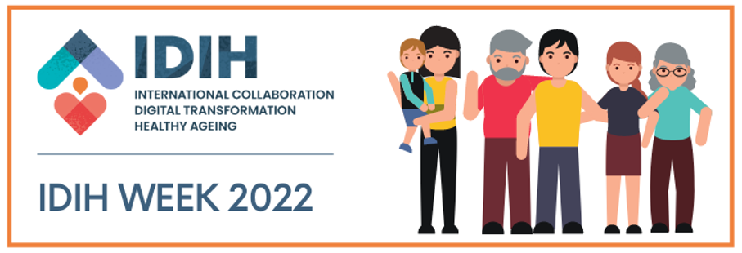
IDIH Week 2022 | 21 – 24 March 2022
4 day online international event dedicated to researchers, innovators, care providers and users associations dealing with Digital Health for Active and Healthy Ageing (AHA).
Sessions dedicated to Information, Networking&Matchmaking, Co-creation & Regional Workshops
https://health-innovation-community-platform.b2match.io/

